Slide 1


Lab 0 – Car Assembly
MIT Beaver Works Racecar Curriculum
https://matthewcalligaro.github.io/RacecarWebsite/

Slide 2
Lab Objectives
Main objective: Build a racecar
Learning objectives
Understand the hardware of the RACECAR-MN
Learn how to use common pieces of hardware and tools
Gain experience translating 2D pictures and diagrams into a 3D product

Slide 3
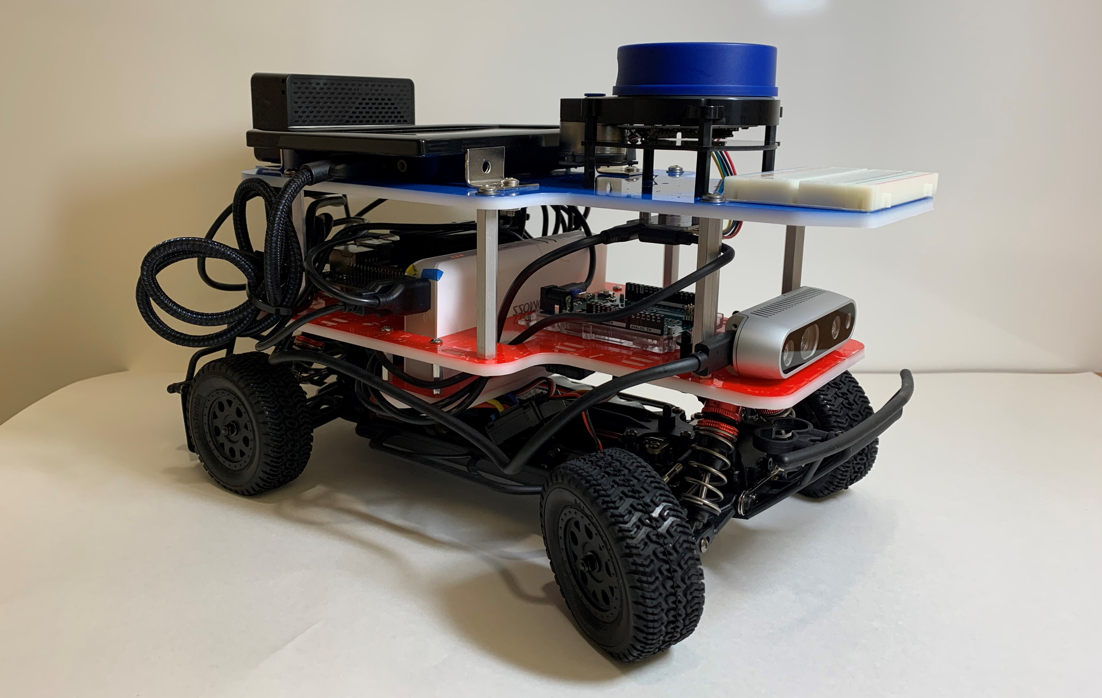
Finished Car

Slide 4
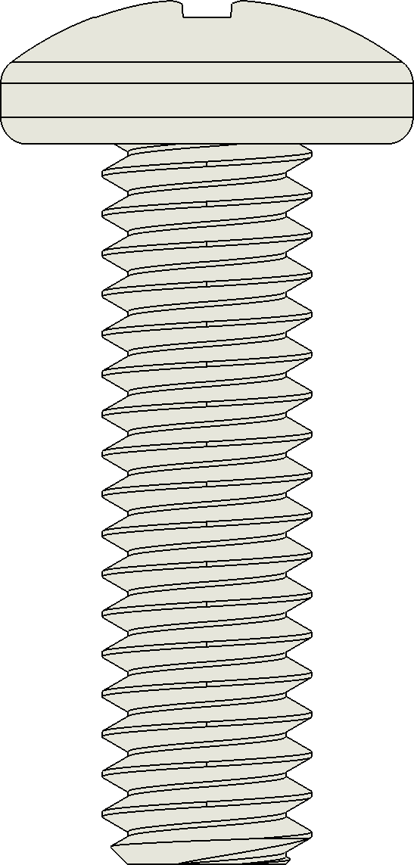
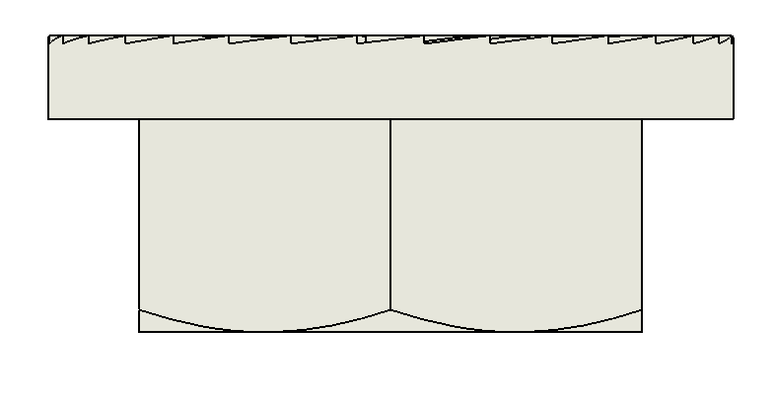
Threads
Threads: metal spirals that allow two pieces to lock together
Every threaded rod should attach to exactly one threaded hole
Any holes in between must be larger than the threads
Hole larger than threads
Threaded hole
Threads
Threaded rod

Slide 5
Tapping
Thru hole (larger than threads)
Some hardware (like standoffs and nuts) have pre-threaded holes
We can also tap a hole without threads by twisting in a rod with threads larger than the hole (which cuts threads into the tap hole)
Once again, there should be exactly one tap hole
Tap hole (smaller than threads)
Threaded rod

Slide 6
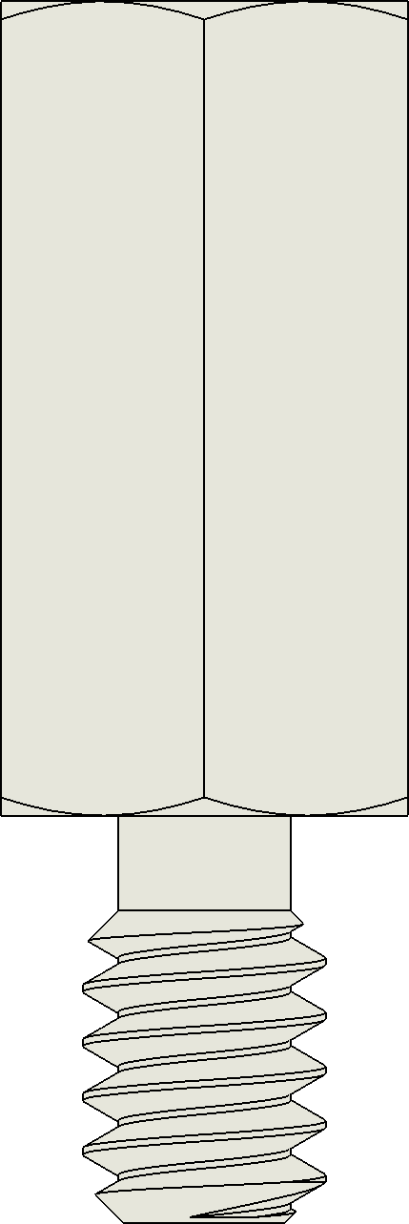
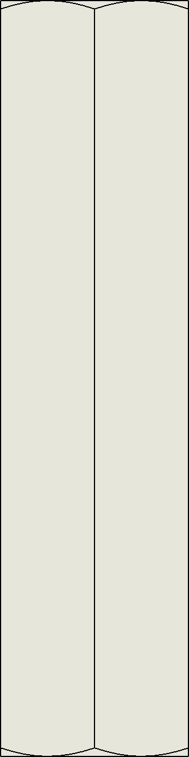
Hardware
Screw
MF Standoff
FF Standoff
Head
Threaded Hole
Threaded Holes
Threads
Threaded rod
Threaded rod

Slide 7
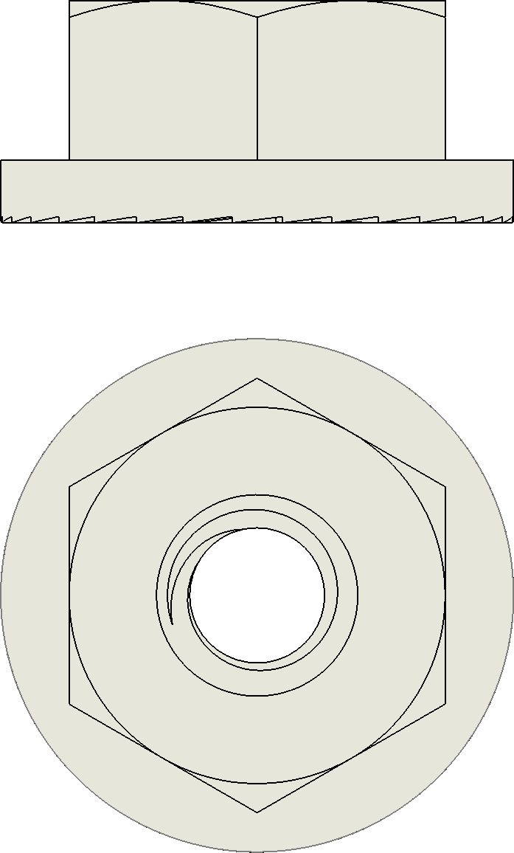

Hardware
Locknut
Washer
Unthreaded hole
Side view
Threaded Hole
Top view

Slide 8
Screw Dimensions
4-40 5/8 screw (C)
Diameter
Length
(inches)
Letter for RACECAR-MN*
Threads
per inch
(determined by thread pitch)
Length
Thread pitch
*We have lettered the screws in the RACECAR-MN from largest (A) to smallest (F) to help identify them
(Letters G and H are metric screws)
Diameter

Slide 9
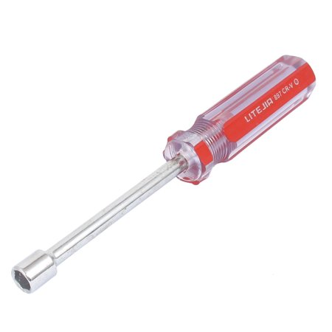
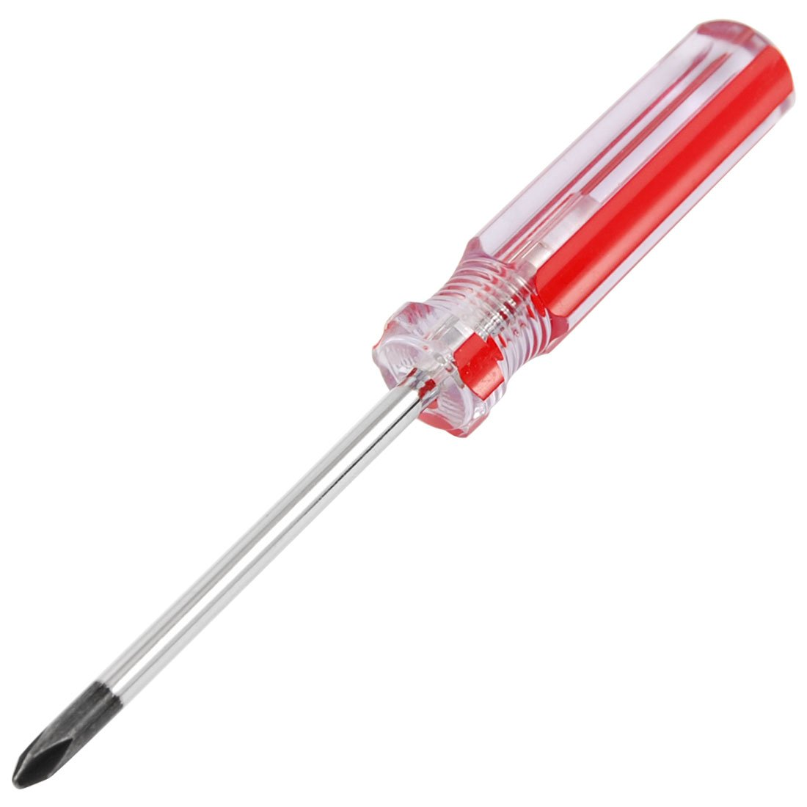

Tools
Philips Screwdriver
Hex Screwdriver
Adjustable Wrench
Tightens locknuts and large standoffs
Tightens screws
Tightens standoffs

Slide 10
Tightness
The instructions refer to the following levels of tightness:
Partial: Do not tighten the screw all of the way and intentionally leave extra room so the part is free to move
Very gentle: Slowly tightening the screw or MF standoff and stop as soon it touches the part
Gentle: Slowly tighten the screw until it touches the part, then apply a small amount of pressure to tighten it further
Moderate: Slowly tighten the screw until it touches the part, then apply a moderate amount of pressure to tighten it further
Tight: Tighten the screw with a large amount of pressure
Very tight: Tighten the screw as much as you can without hurting yourself

Slide 11

Tightening Patterns
Use the following steps when a part is attached with multiple screws:
Screw in each screw partially (such that the part can still move freely)
Gently tighten each screw and use a crisscross pattern in which you move to the next screw that is farthest away
Repeat this same pattern a second time, this time tightening screws to the desired tightness
This ensures consistent tightness and avoids unwanted stress on the part
A crisscross pattern

Slide 12
Tightening Patterns
In what order should we tighten these screws?

Slide 13
Tightening Patterns
1
3
4
2

Slide 14
Tightening Patterns
How about these screws?

Slide 15
Tightening Patterns
1
5
3
4
6
2

Slide 16
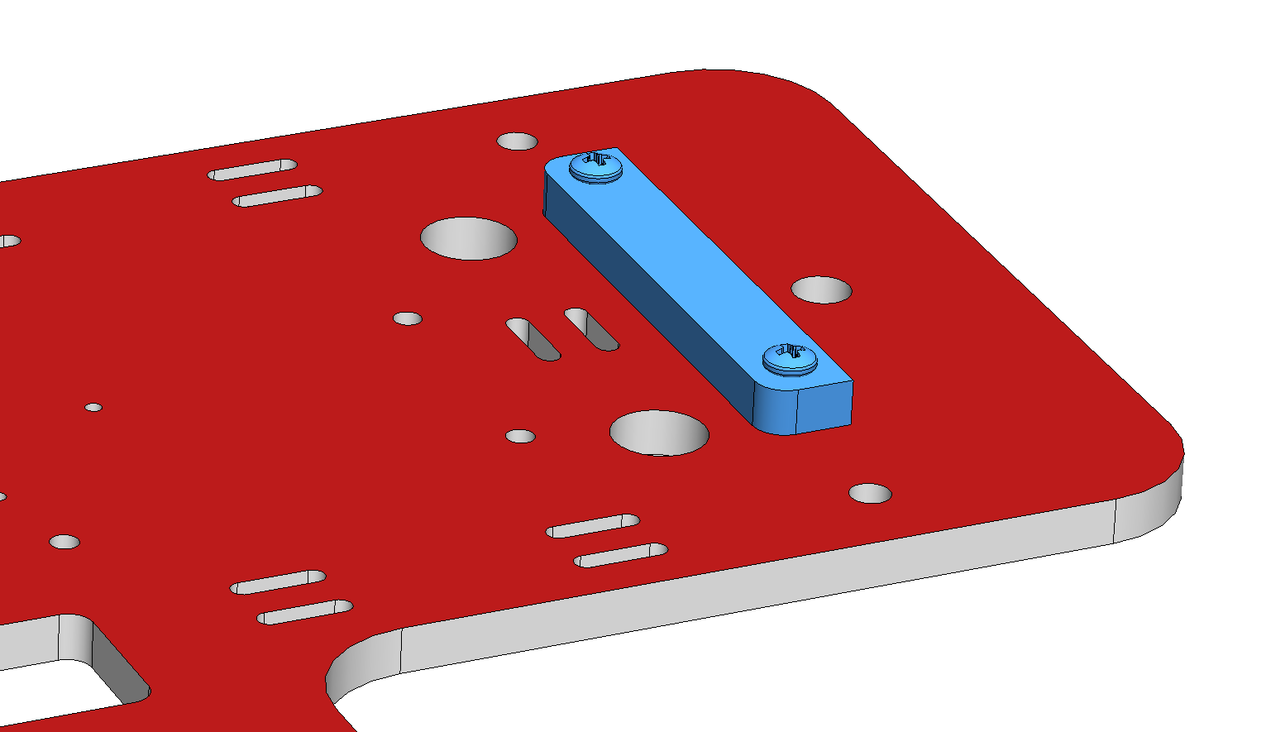
Assembly Guide
The assembly guide contains step by step instructions with pictures and diagrams for assembling the RACECAR-MN
Parts are written in bold and can be found in the parts list
The new part(s) added in each step are shown in blue

Slide 17
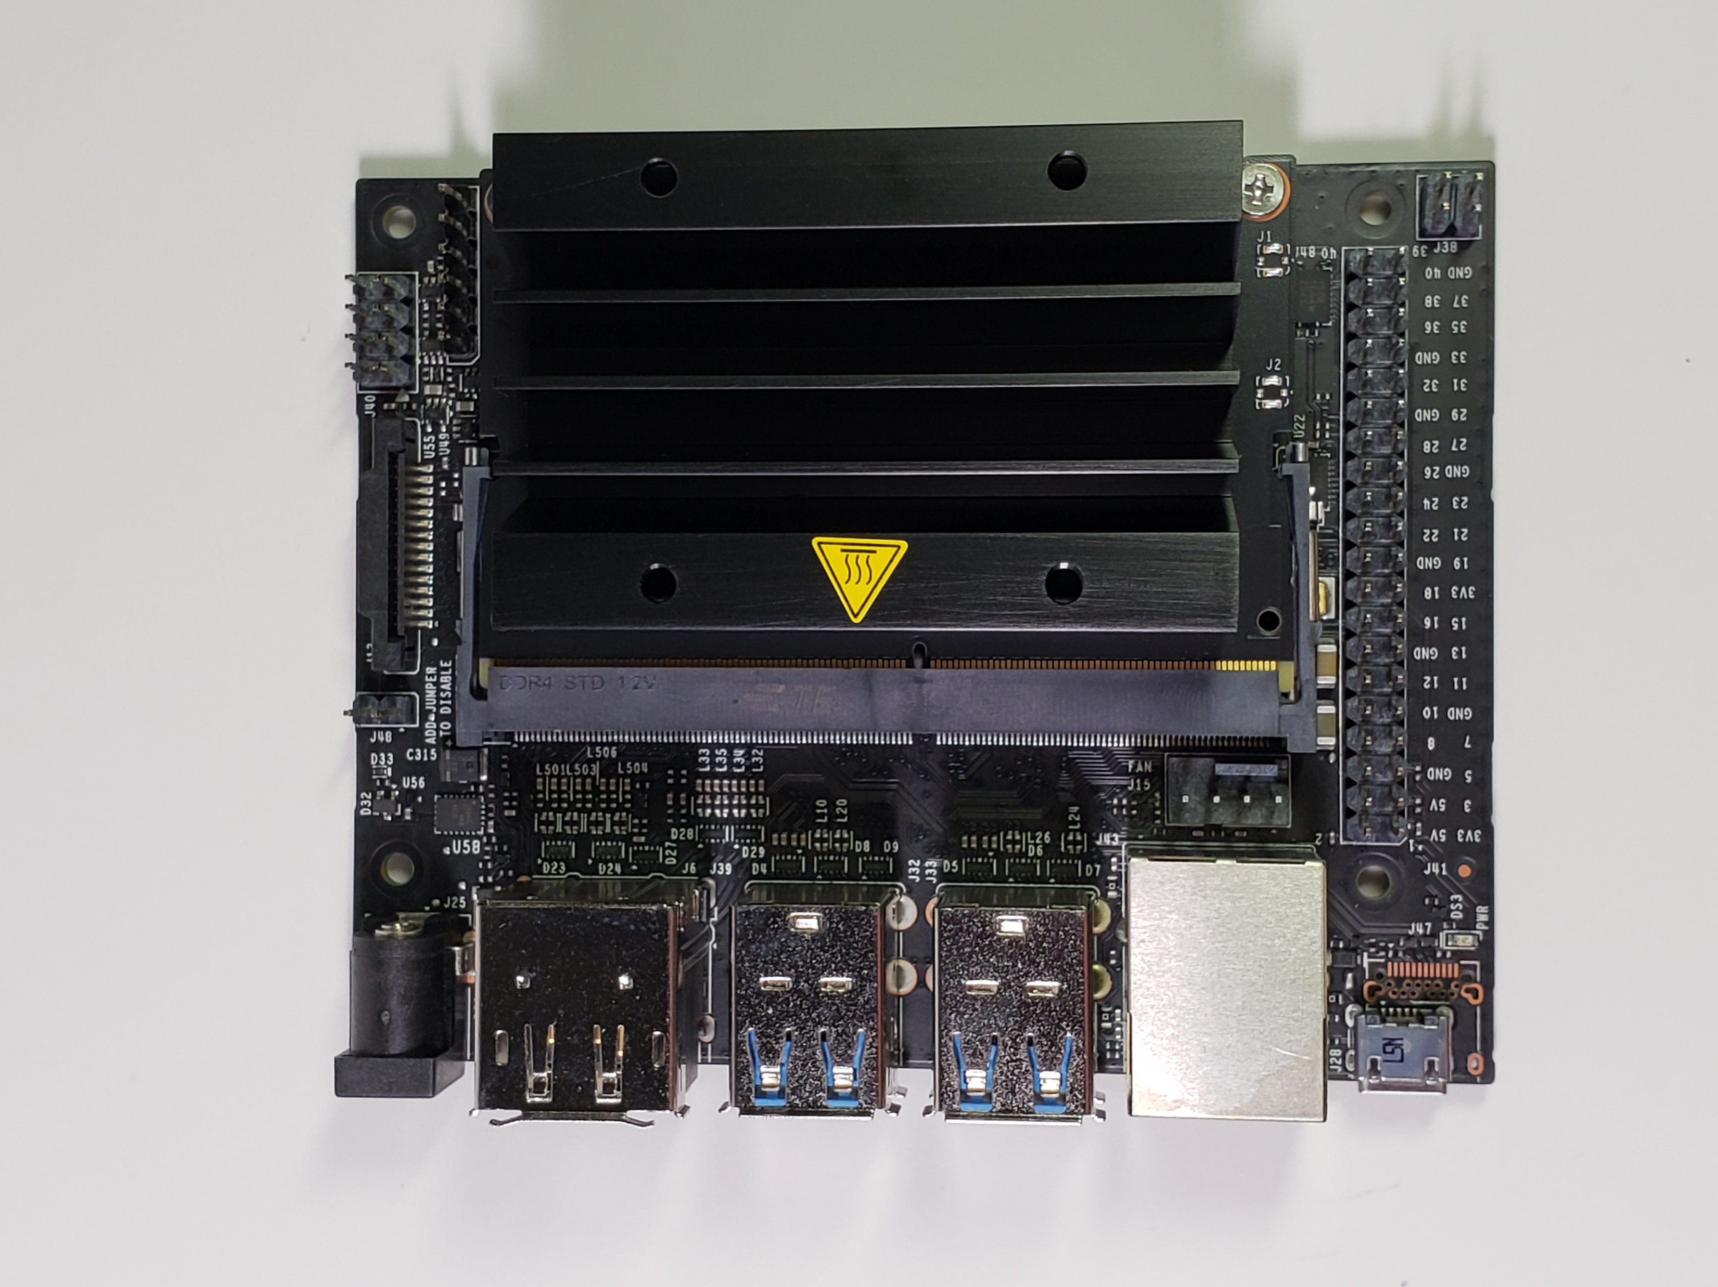
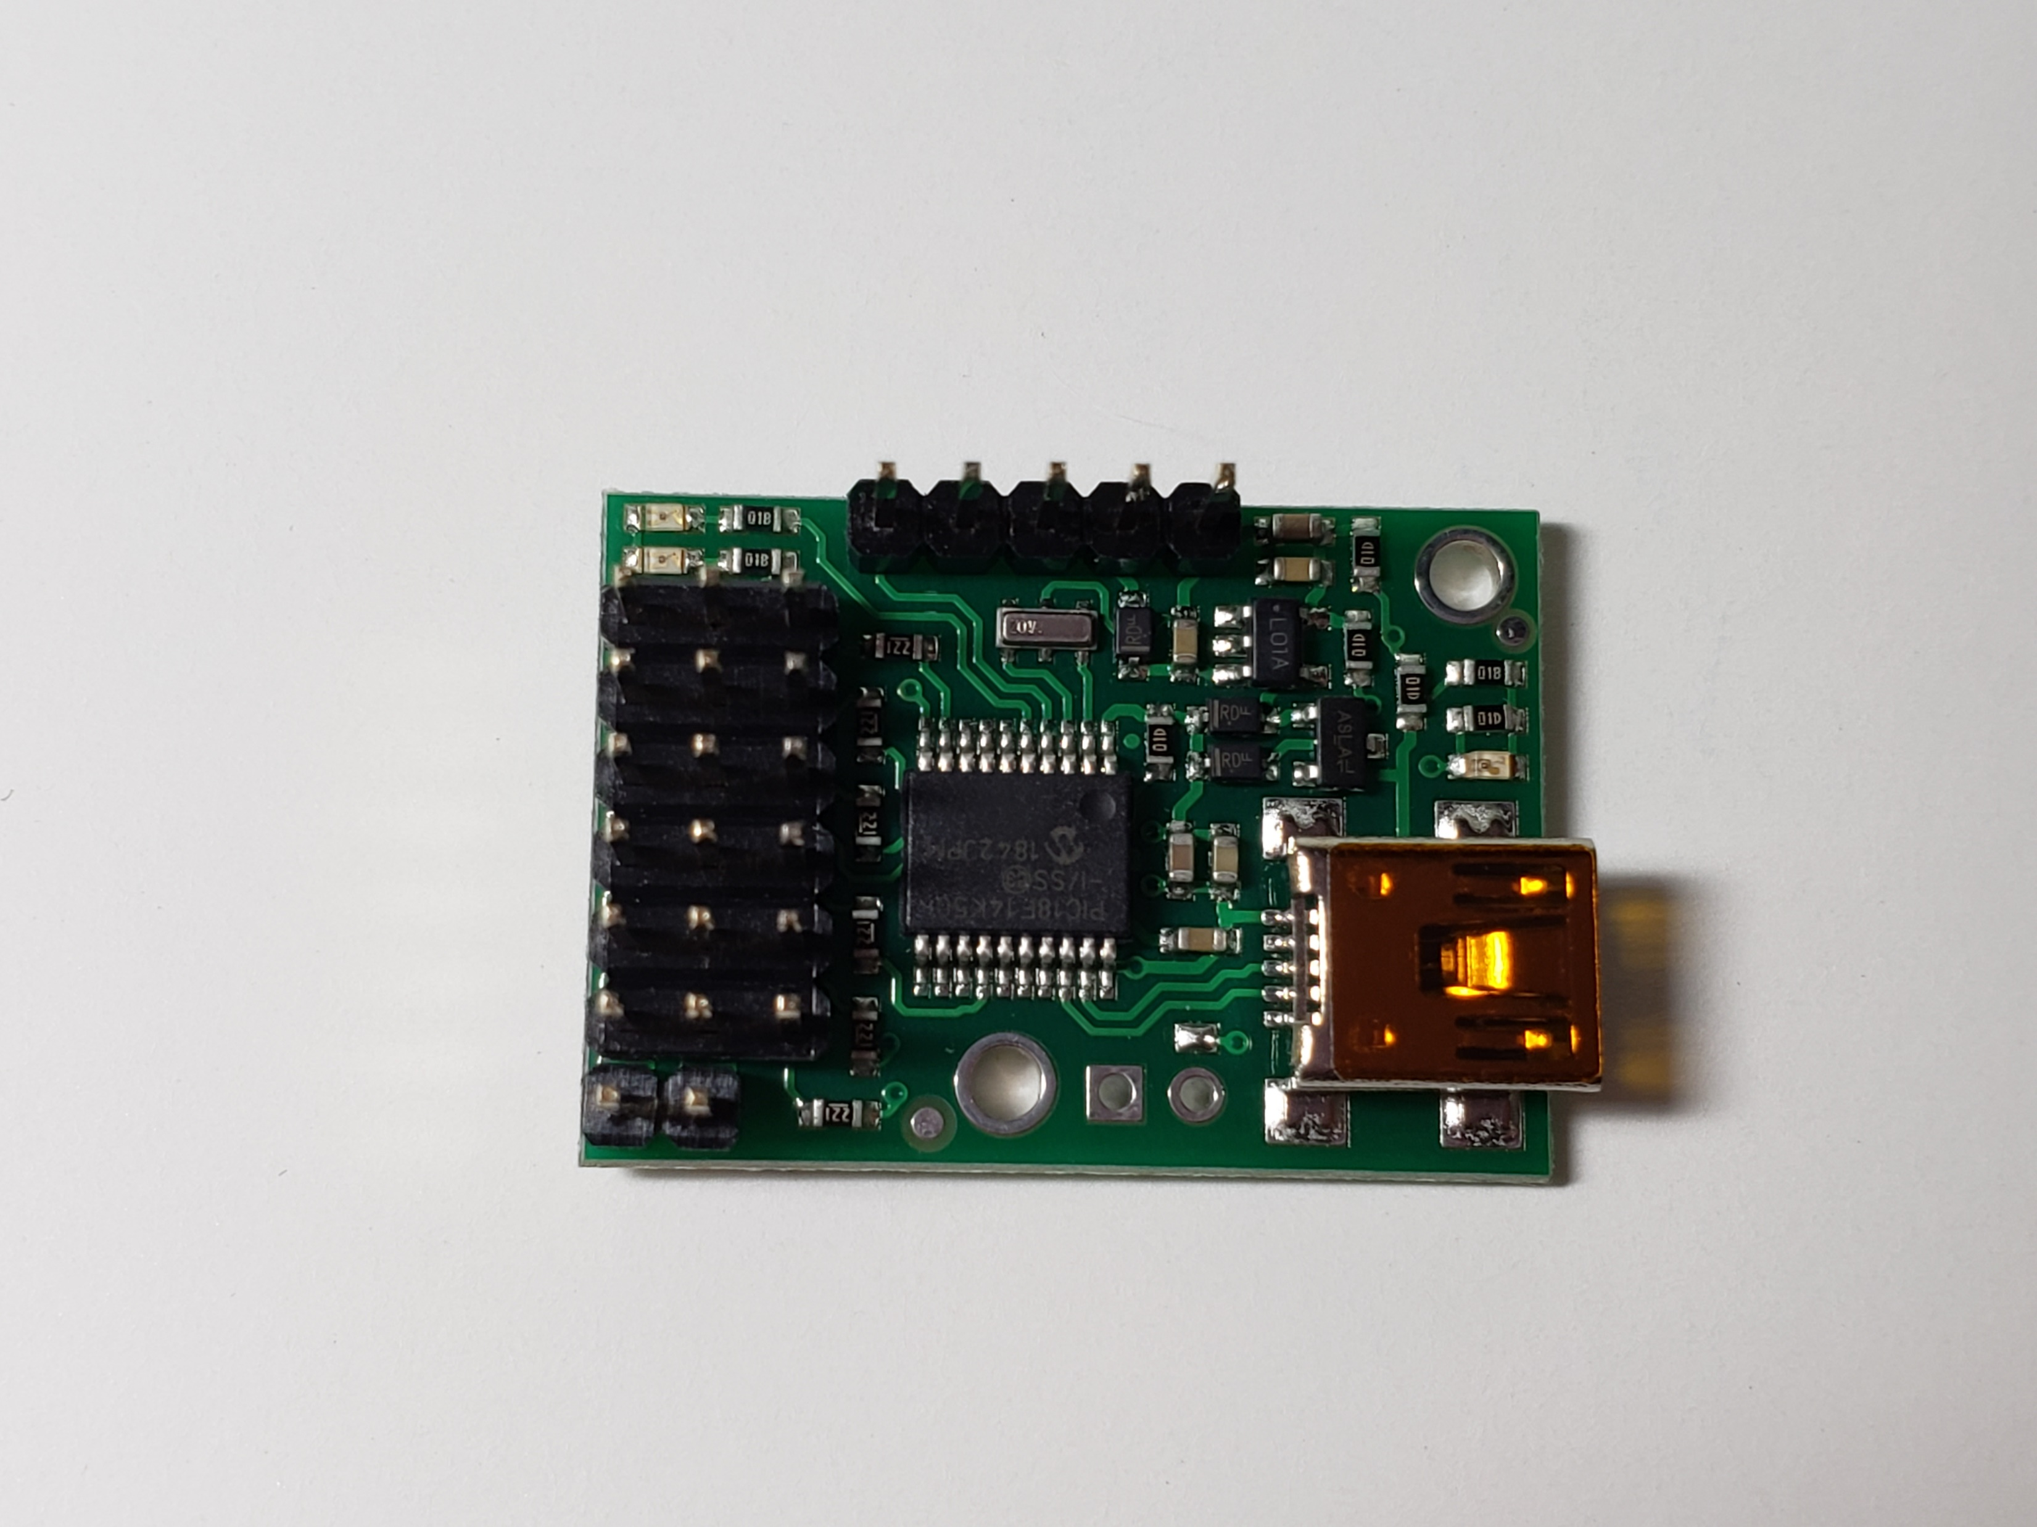
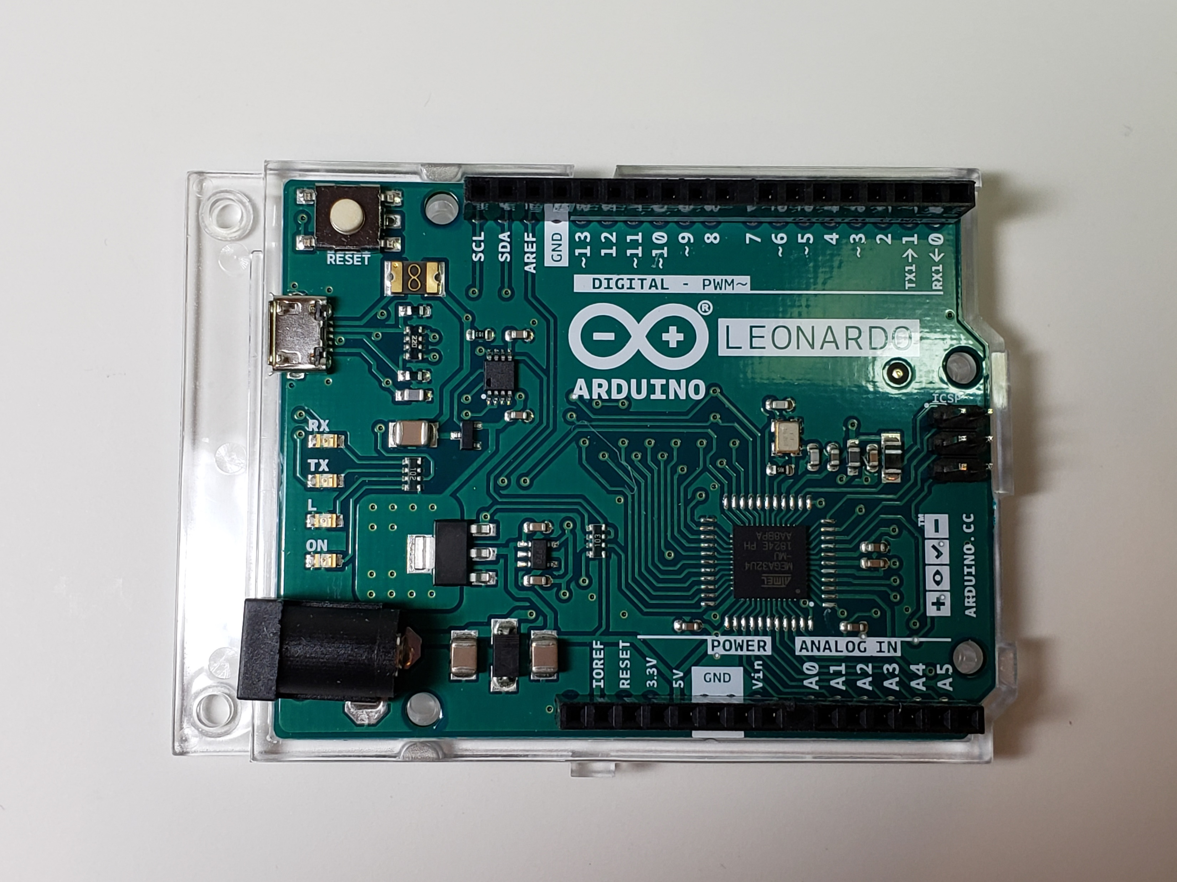
Safety Precautions
Touch a piece of grounded metal (such as a door handle) to discharge static before handling any electronic parts

Slide 18

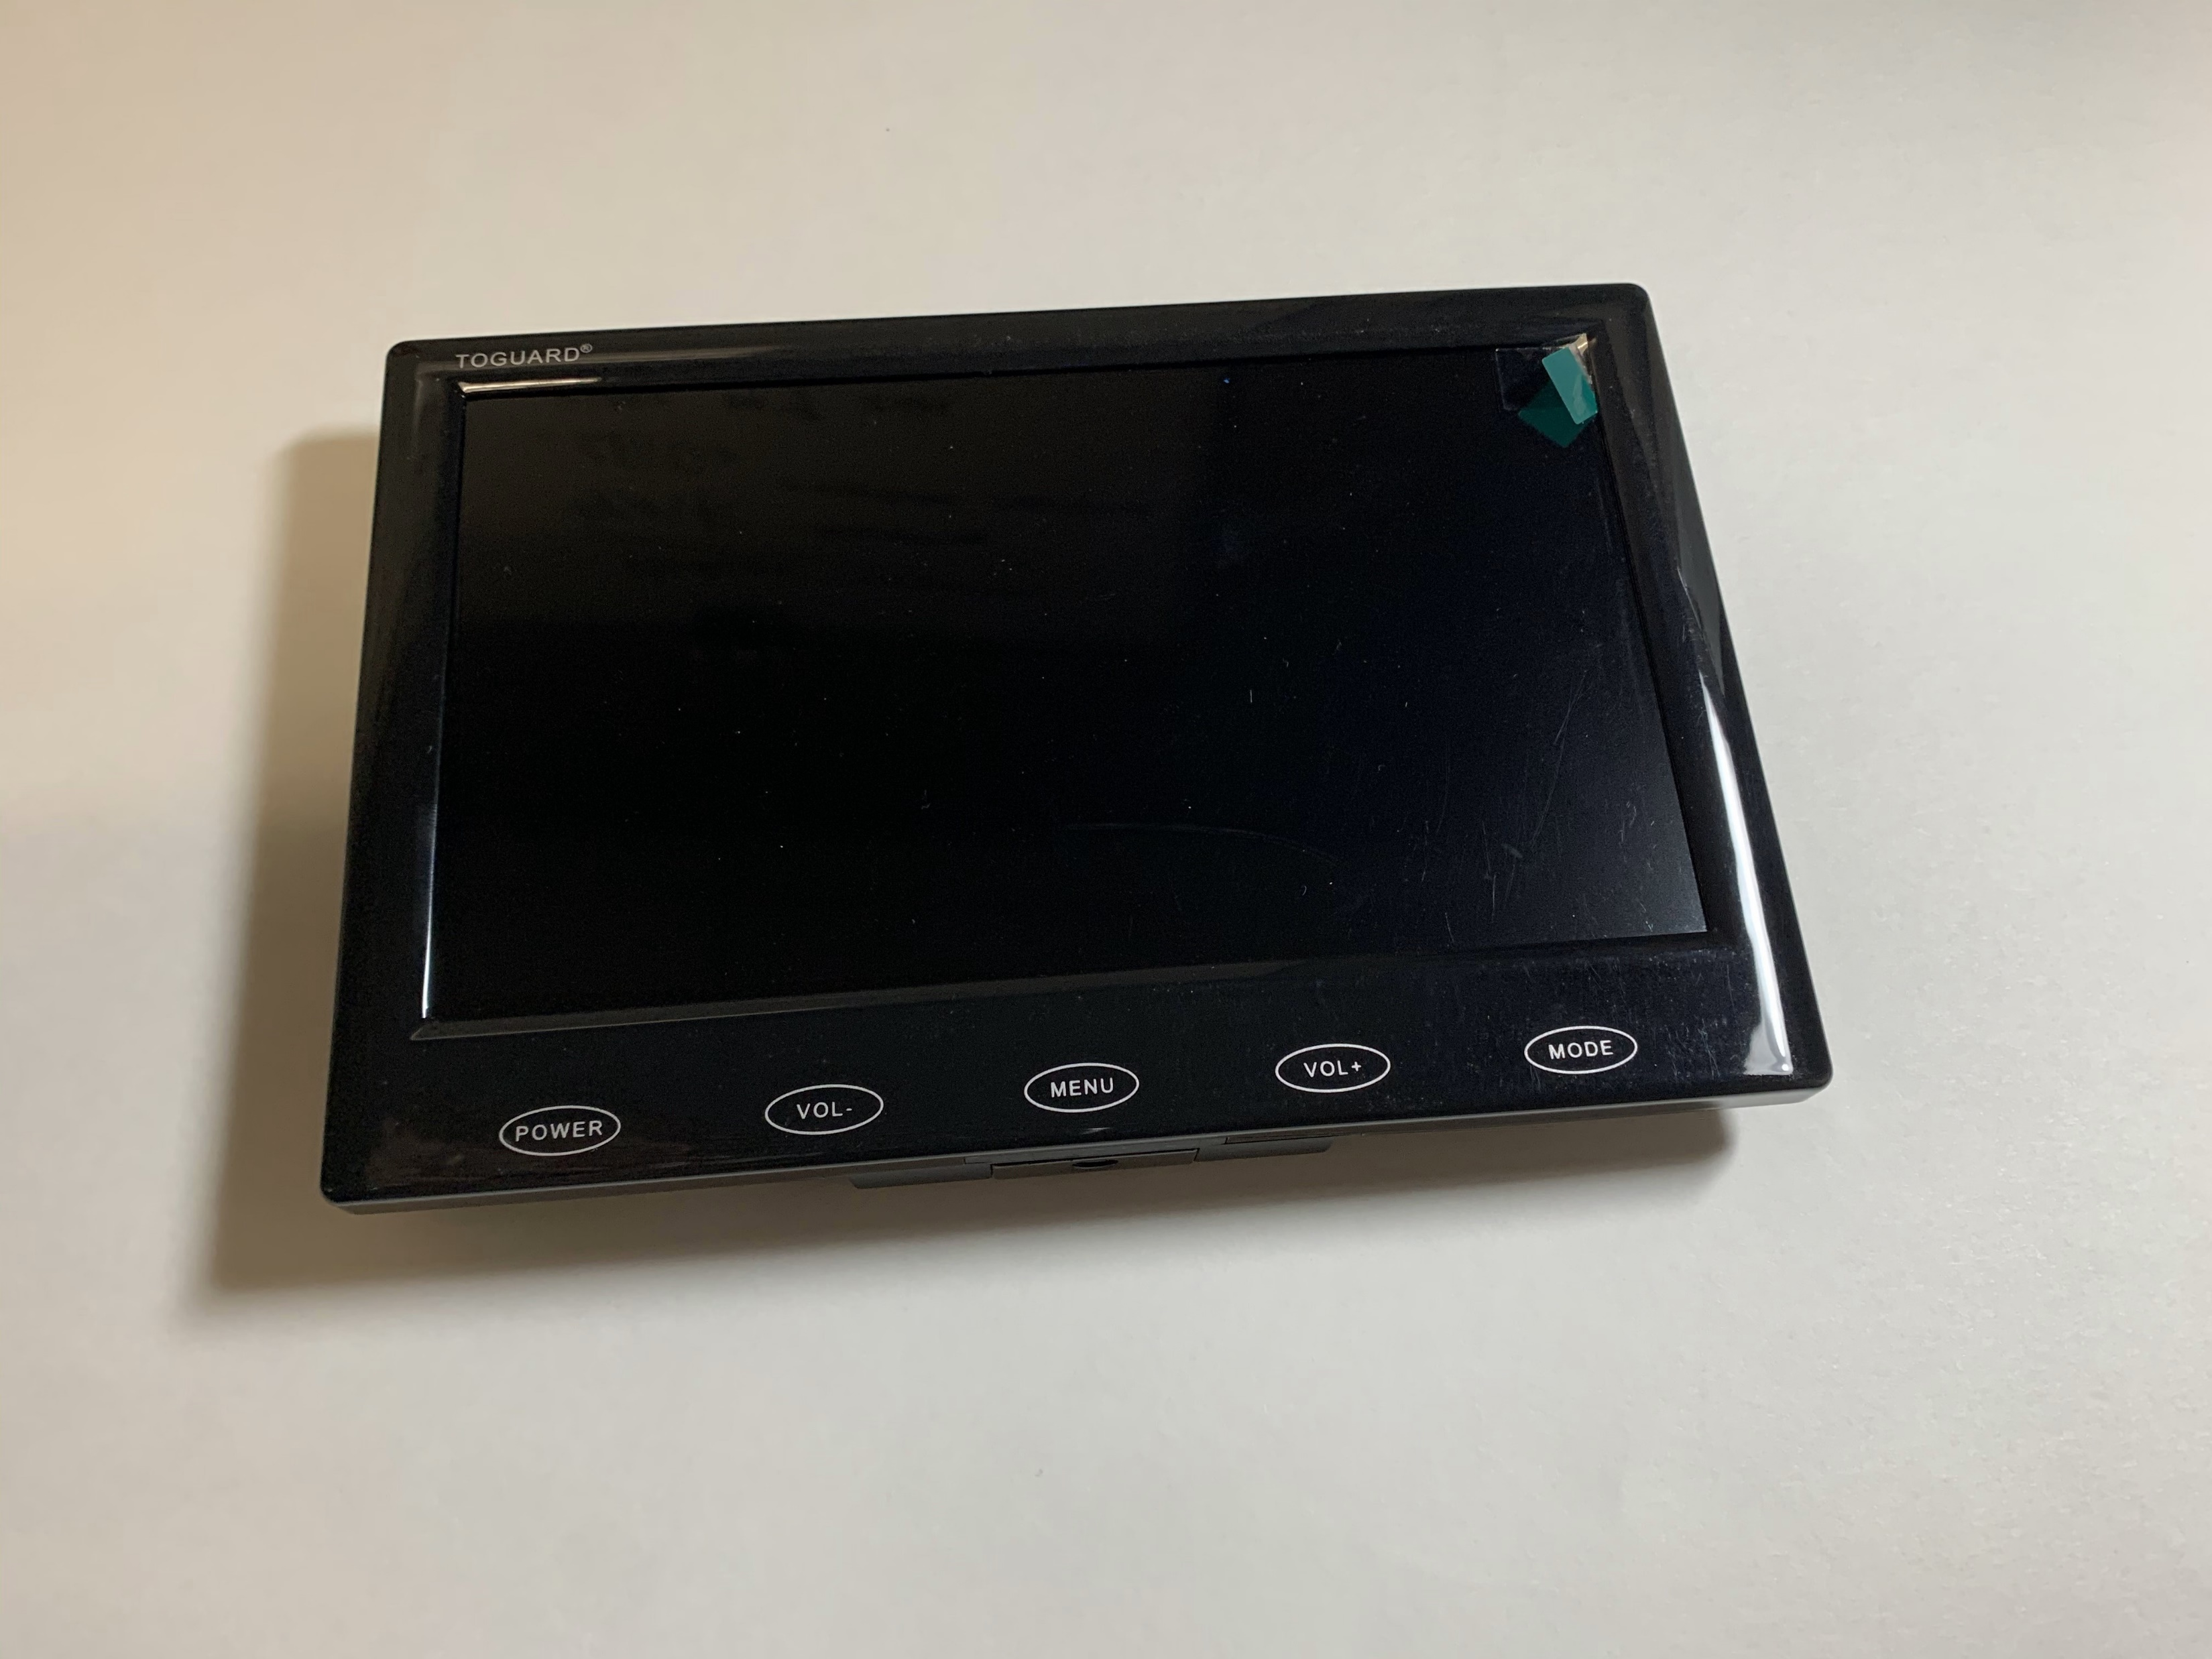
Safety Precautions
Leave the protective film on the camera and monitor until you are finished assembling the car

Slide 19
Good luck and have fun!
Let us know if you need any help during the lab

